Slide 1
Getting Started with Apache Kafka
WHY APACHE KAFKA

Slide 2



What Is Apache Kafka?
Microsoft SQL Server
ElasticSearch
MongoDB
Oracle
Apache Kafka
MySQL
Hadoop
“A high-throughput distributed messaging system.”

Slide 3
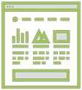

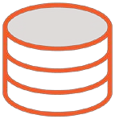
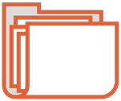



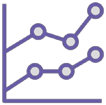
What a Typical Enterprise Looks Like
RDBMS
LOGS
NOSQL
QUEUES
BLOBS
DW
HADOOP
SEARCH
ANALYSIS

Slide 4

Database replication
Log shipping
Extract, Transform, and Load (ETL) Messaging
Custom middleware magic

Slide 5


Database Replication and Log Shipping
RDBMS to RDBMS only
Database-specific
Tight coupling (schema)
Performance challenges (log shipping) Cumbersome (subscriptions)

Slide 6


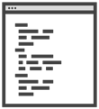
Extract, Transform, and Load (ETL)
Typically proprietary and costly
Lots of custom development Scalability challenged Performance challenged
Often times requires multiple instances

Slide 7


Messaging
Limited scalability
Smaller messages
Requires rapid consumption Not fault-tolerant (application)

Slide 8

















Perils of Messaging Under High Volume
Publishers
High volume? Message size? No throttle?
Single host? Local storage? Message buildup?
BROKER
Consumers
No consumption? Slow consumption?

Slide 9






Perils of Messaging With Application Faults
Publishers
BROKER
Message processing bug
Consumers

Slide 10

Middleware Magic
Increasingly complex
Deceiving Consistency concerns Potentially expensive

Slide 11

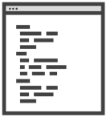




Middleware Challenges
Multi-write pattern
Message broker pattern
Atomic transaction
Coordination logic
Competing consumers
1
2
1
2
Non-consuming consumer

Slide 12

Isn’t There a Better Way?
To move data around:
Cleanly
Reliably
Quickly
Autonomously

Slide 13
That’s What LinkedIn Asked in 2010…

Slide 14

High Volume:
Over 1.4 trillion messages per day
175 terabytes per day
650 terabytes of messages consumed per day
Over 433 million users
High Velocity:
Peak 13 million messages per second
2.75 gigabytes per second
High Variety:
Multiple RDBMS (Oracle, MySQL, etc.)
Multiple NoSQL (Espresso, Voldemort)
Hadoop, Spark, etc.

Slide 15


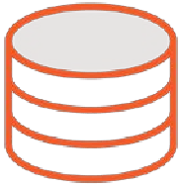



Pre-2010 LinkedIn Data Architecture
skills _{jobs}
recommendations
ads search
network updates ^{comments}
mail
groups
people you may know
profile news stats
…
…

Slide 16
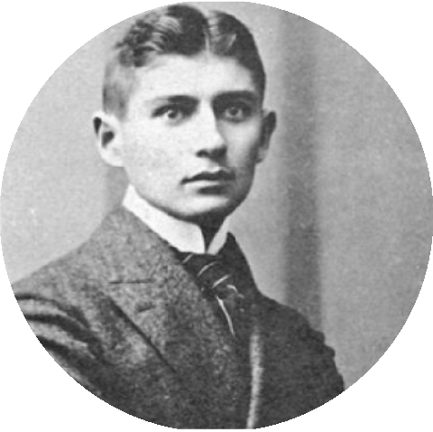
kaf•ka•esque
/’káf, kə, ɛsk/ | adjective
Basically it describes a nightmarish situation which most people can somehow relate to, although strongly surreal.
synonyms: surreal, lucid, spoilsbury toast boy Usage: “Whoa! This flick is way kafkaesque…”
Franz Kafka
Source: Urban Dictionary

Slide 17

Next-generation Messaging Goals
High throughput
Horizontally scalable Reliable and durable
Loosely coupled Producers and Consumers Flexible publish-subscribe semantics

Slide 18
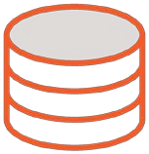




Post-2010 LinkedIn Data Architecture
LOB APPS
APPS
DBs
LOGS
consume
consume
consume
consume consume consume
publish
publish
publish
topic
topic
topic
…
consume
consume publish
consume
consume
publish
publish
DW
MARTS
HDP
SEARCH
OPS
…

Slide 19






Timeline of Events
2010
Initial Kafka Deployment @ LinkedIn
Today
1.1 Trillion messages per day @ LinkedIn
2003
LinkedIn Launch
2009
Kafka Inception
Development begins
2011
Kafka Open Sourced Apache Software Foundation

Slide 20
Apache Kafka Adoption
7X since 2015
Yahoo Etsy Microsoft Bing Mailchimp
Uber Oracle
Goldman Sachs Netflix
PayPal
Square Coursera IBM
Pintrest Twitter
Airbnb Spotify Ancestry LinkedIn Hotels.com

Slide 21

Kafka is a distributed messaging system
Designed to move data at high volumes
Addresses shortcomings of traditional data movement tools and approaches
Invented by LinkedIn to address data growth issues common to many enterprises
Open-sourced under Apache Software Foundation in 2012
First-choice adoption for data movement for hundreds of enterprise and internet- scale companies
Summary

